Slide 1
Software Design Pattern
Parinya Ekparinya
Parinya.Ek@kmitl.ac.th
Software Architecture and Design

Slide 2
Acknowledgement
The content of the following slides are partially based on the listed material as follows:
Object-Oriented Patterns & Frameworks by Dr. Douglas C. Schmidt
https://en.wikipedia.org/wiki/Factory_method_pattern
https://en.wikipedia.org/wiki/Abstract_factory_pattern
https://en.wikipedia.org/wiki/Builder_pattern
https://en.wikipedia.org/wiki/Prototype_pattern
https://en.wikipedia.org/wiki/Singleton_pattern
https://en.wikipedia.org/wiki/Dependency_injection

Slide 3
(Software) Design Pattern
A software design pattern is a general, reusable solution to a commonly occurring problem in the context of modular software design.
In 1994, the concept of software design patterns for object-oriented software was published in “Design Patterns: Elements of Reusable Object-Oriented Software” by Erich Gamma, John Vlissides, Ralph Johnson, and Richard Helm.
People often call these four authors “the Gang of Four”.
So, their book is often called “the GoF book”.
Originally, GoF design patterns covers 23 classic design patterns.
After that people keep introducing more design patterns.

Slide 4

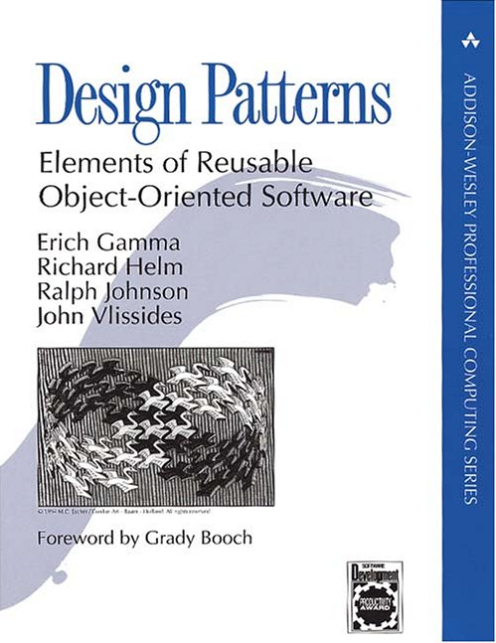
The GoF Book (Smalltalk)

Slide 5

Another useful book (Java)

Slide 6
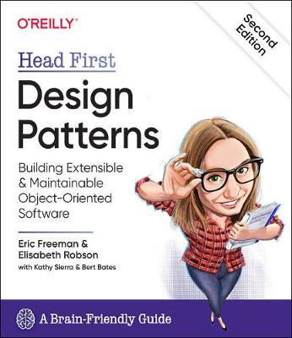
2nd Edition December 2020

Slide 7
Relationship with Other Design Concepts
Architectural Styles
Reference Architectures / Domain Specific Architectures
Design Patterns
Design/Coding Idioms

Slide 8
Benefits & Limitations of Design Patterns
Benefits
Design reuse
Uniform design vocabulary
Enhance understanding, restructuring, & team communication
Basis for automation
Transcends language-centric biases/myopia
Abstracts away from many unimportant details
Limitations
Require significant tedious & error-prone human effort to handcraft pattern implementations design reuse
Can be deceptively simple uniform design vocabulary
May limit design options
Leaves important (implementation) details unresolved

Slide 9
WARNING: Overuse of design patterns can lead to code that is downright over-engineered. Always go with the simplest solution that does the job and introduce patterns only where the need emerges.
Freeman, E., Robson, E., Bates, B., & Sierra, K. (2008). Head first design patterns. " O'Reilly Media, Inc."

Slide 10
Four Basic Parts of a Pattern
Name
Problem (including "applicability")
Solution (both visual & textual descriptions)
Consequences (the results and trade-offs of applying the pattern)

Slide 11
Classification of Design Patterns
Creational patterns provide object creation mechanisms that increase flexibility and reuse of existing code.
Structural patterns explain how to assemble objects and classes into larger structures, while keeping the structures flexible and efficient.
Behavioral patterns take care of effective communication and the assignment of responsibilities between objects.

Slide 12
Creational Design Patterns
Factory Method
Abstract Factory
Builder
Prototype
Singleton
Dependency Injection

Slide 13

Factory Method

Slide 14
Factory Method: Problem
How can an object be created so that subclasses can redefine which class to instantiate?
How can a class defer instantiation to subclasses?
Applicability
When a class cannot anticipate the objects it must create or a class wants its subclasses to specify the objects it creates

Slide 15
Factory Method: Solution
Intent
Provide an interface for creating an object, but leave choice of object’s concrete type to a subclass
The Factory Method design pattern describes how to solve such problems:
Define a separate operation (factory method) for creating an object
Create an object by calling a factory method

Slide 16
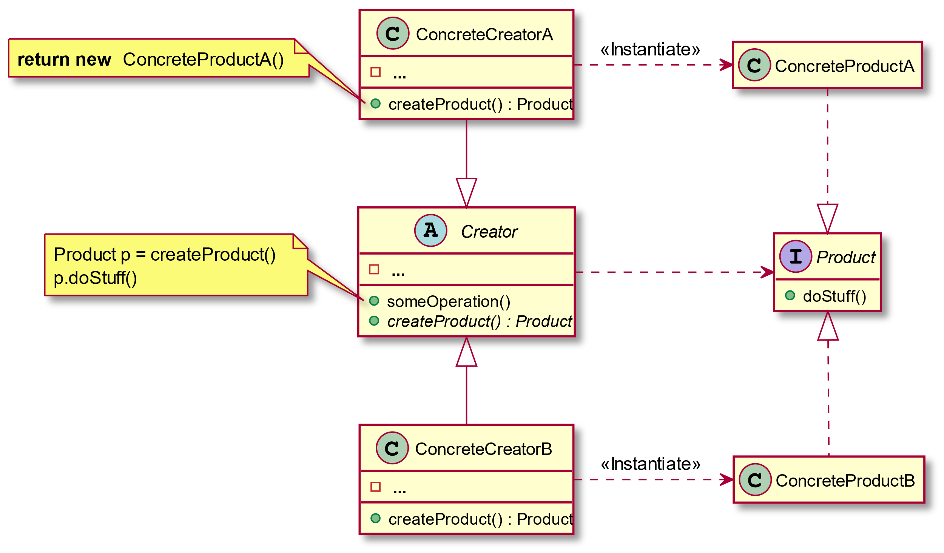

Slide 17
Factory Method: Consequences
By avoiding to specify the class name of the concrete class & the details of its creation, the client code has become more flexible isolates code for construction & representation.
The client is only dependent on the interface.
Construction of objects requires one additional class in some cases.

Slide 18
Factory Method: Examples
Factory Method (refactoring.guru)
Factory method pattern – Wikipedia

Slide 19

Abstract Factory

Slide 20
Abstract Factory: Problem
How can an application be independent of how its objects are created?
How can a class be independent of how the objects it requires are created?
How can families of related or dependent objects be created?
Applicability
When clients cannot anticipate groups of classes to instantiate

Slide 21
Abstract Factory: Solution
Intent
Create families of related objects without specifying subclass names
The Abstract Factory design pattern describes how to solve such problems:
Encapsulate object creation in a separate (factory) object. That is, define an interface (AbstractFactory) for creating objects, and implement the interface.
A class delegates object creation to a factory object instead of creating objects directly.

Slide 22
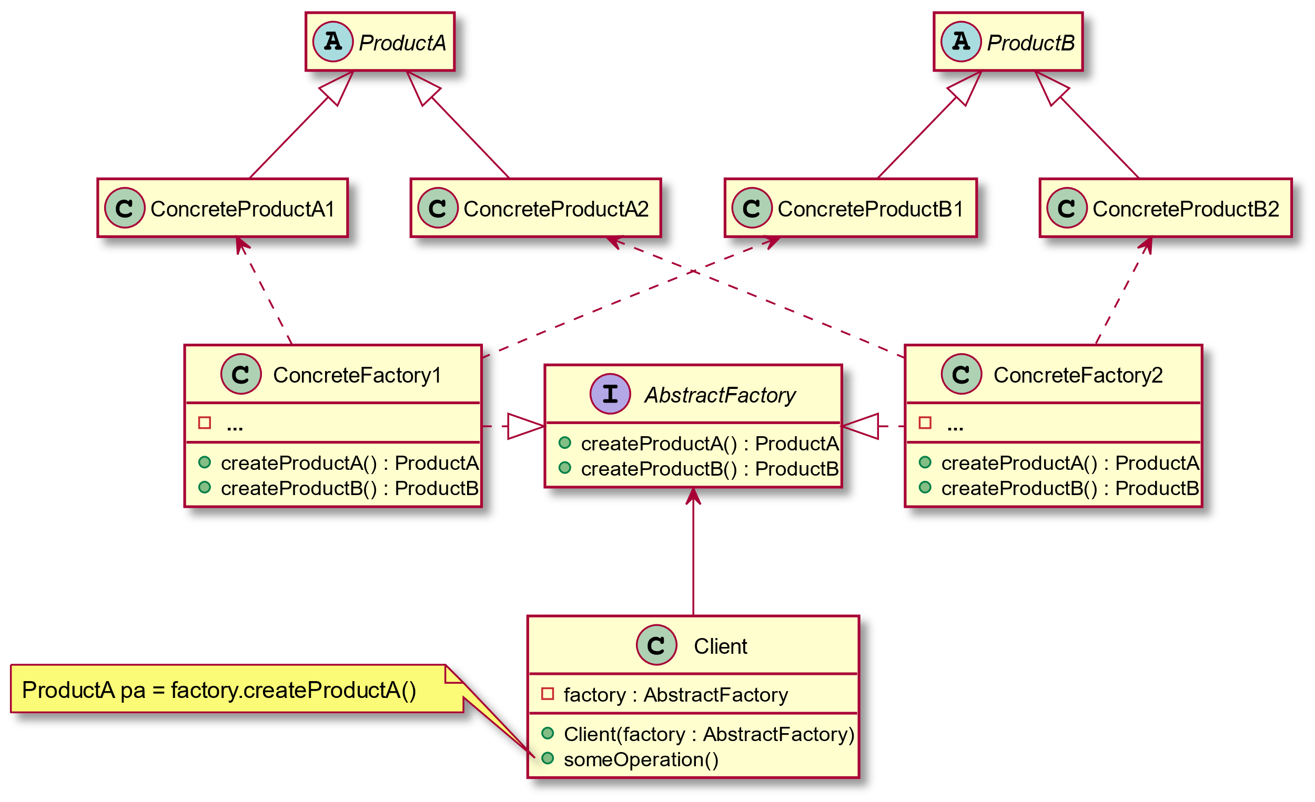

Slide 23
Abstract Factory: Consequences
Flexibility: removes type (i.e., subclass) dependencies from clients
Abstraction & semantic checking: hides product’s composition
Hard to extend factory interface to create new products

Slide 24
Abstract Factory: Examples
Design Patterns: Abstract Factory in Java (refactoring.guru)
Abstract Factory Design Pattern in Java – JournalDev

Slide 25

Builder

Slide 26
Builder: Problem
How can a class (the same construction process) create different representations of a complex object?
How can a class that includes creating a complex object be simplified?
Applicability
Need to isolate knowledge of the creation of a complex object from its parts
Need to allow different implementations/interfaces of an object's parts

Slide 27
Builder: Solution
Intent
Separate the construction of a complex object from its representation so that the same construction process can create different representations
The Builder design pattern describes how to solve such problems:
Encapsulate creating and assembling the parts of a complex object in a separate Builder object
A class delegates object creation to a Builder object instead of creating the objects directly.

Slide 28
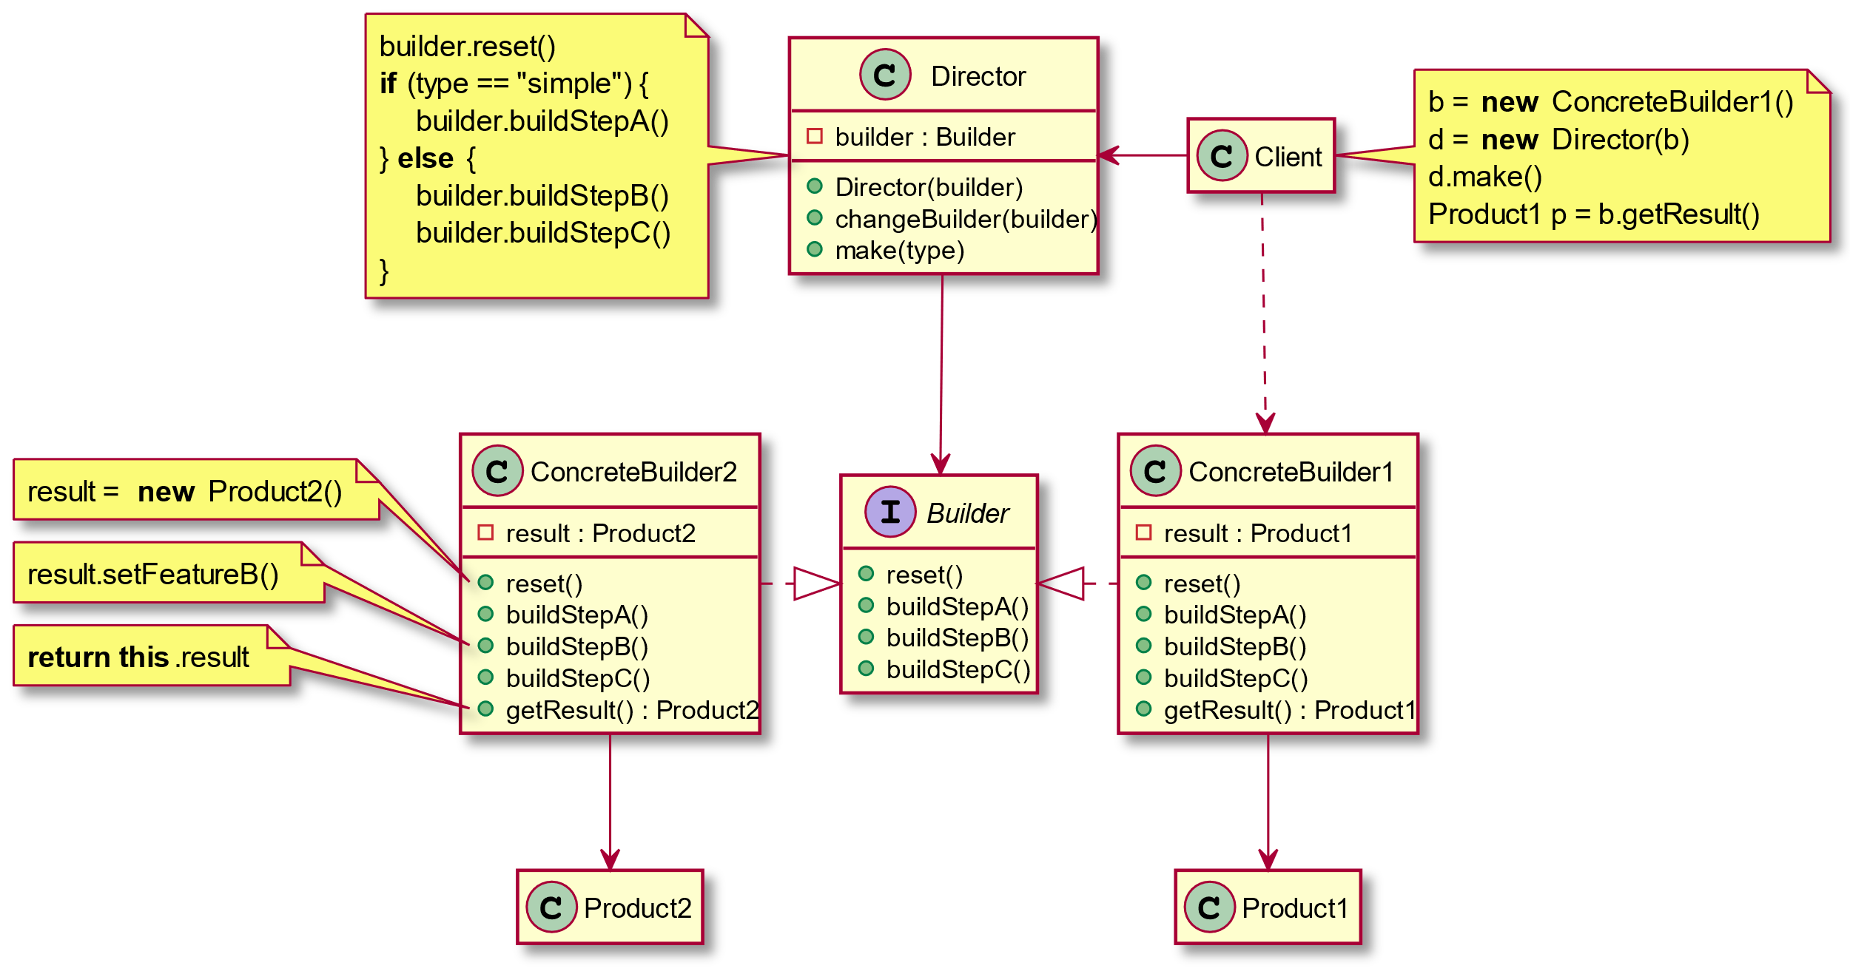

Slide 29
Builder: Consequences
Can vary a product's internal representation
Isolates code for construction & representation
Finer control over the construction process
May involve a lot of classes

Slide 30
Builder: Examples
Design Patterns: Builder in Java (refactoring.guru)
Builder Design Pattern in Java - JournalDev
Implementing the builder pattern in Java 8 - Tutorial (vogella.com)

Slide 31

Prototype

Slide 32
Prototype: Problem
How can objects be created so that which objects to create can be specified at run-time?
How can dynamically loaded classes be instantiated?
Applicability
When a system should be independent of how its products are created, composed, & represented
When the classes to instantiate are specified at run-time

Slide 33
Prototype: Solution
Intent
Specify the kinds of objects to create using a prototypical instance & create new objects by copying this prototype
The prototype design pattern describes how to solve such problems:
Define a Prototype object that returns a copy of itself.
Create new objects by copying a Prototype object.

Slide 34
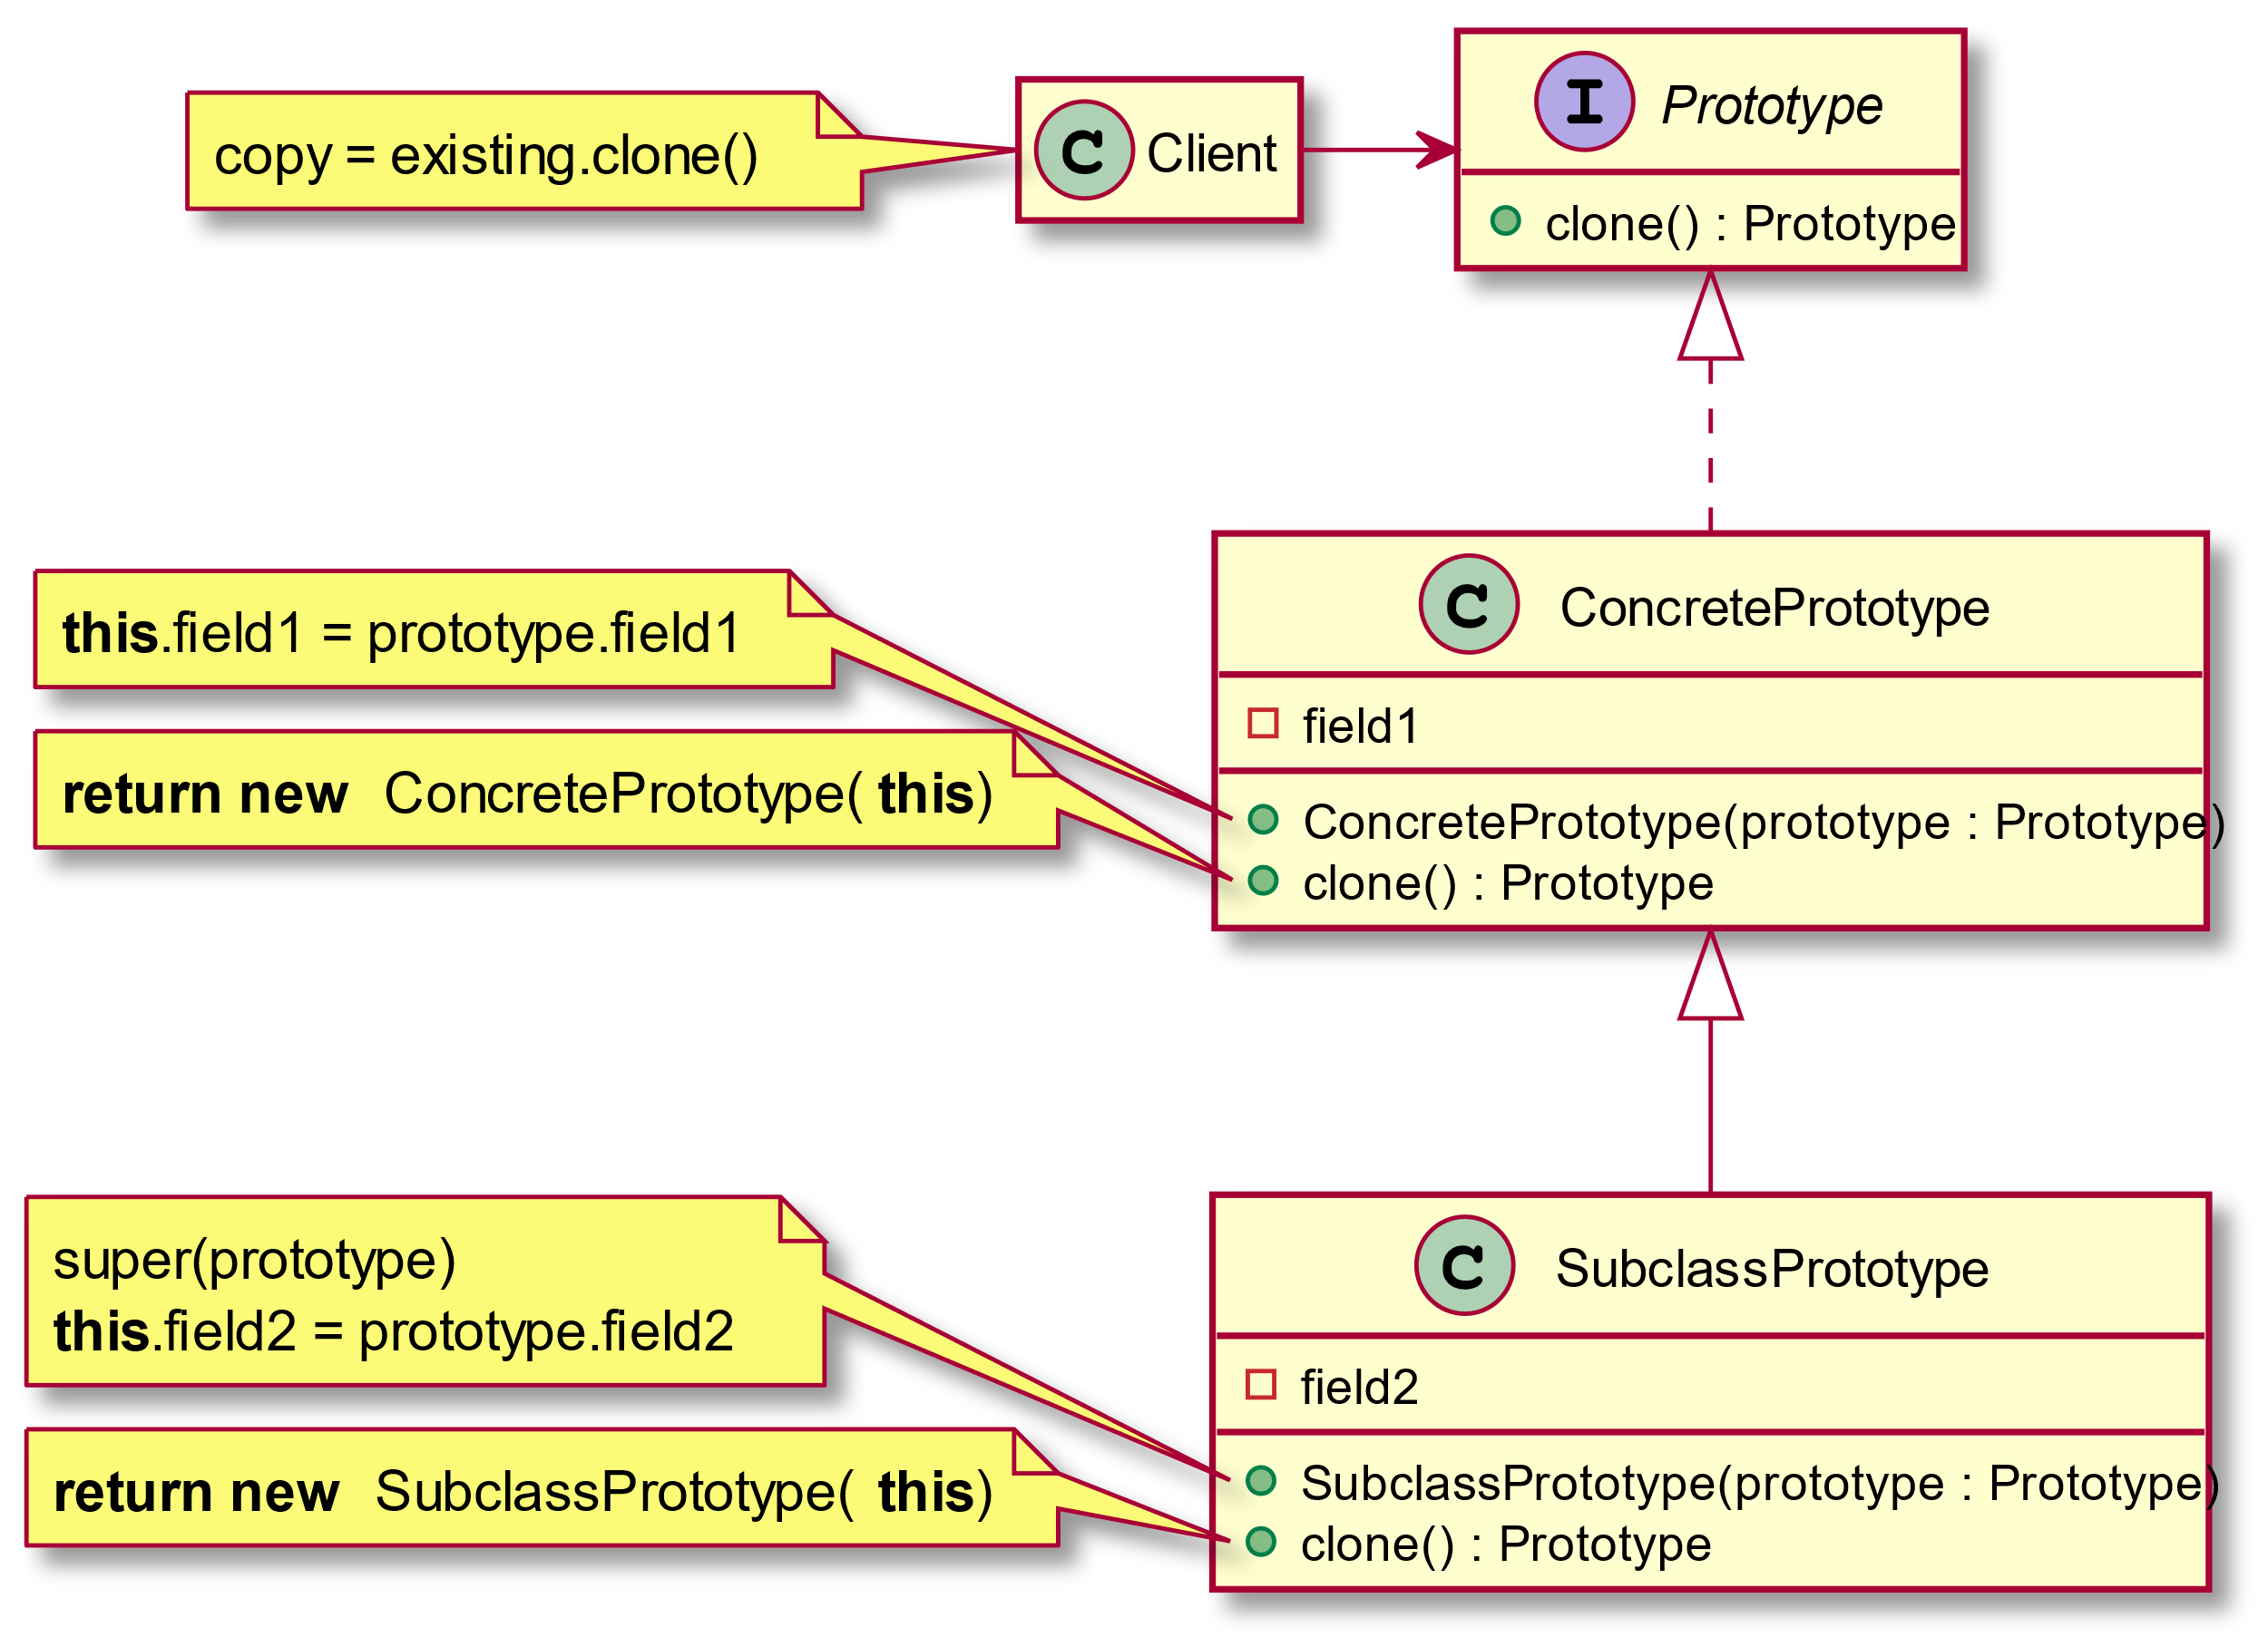

Slide 35
Prototype: Consequences
Can add & remove classes at runtime by cloning them as needed
Reduced subclassing minimizes/eliminates need for lexical dependencies at run-time
Every class that used as a prototype must itself be instantiated
Classes that have circular references to other classes cannot really be cloned

Slide 36
Prototype: Examples
Design Patterns: Prototype in Java (refactoring.guru)
Prototype Design Pattern in Java - JournalDev

Slide 37

Singleton

Slide 38
Singleton: Problem
How to:
Ensure that a class only has one instance
Easily access the sole instance of a class
Control its instantiation
Restrict the number of instances
Applicability
When there must be exactly one instance of a class & it must be accessible from a well-known access point
When the sole instance should be extensible by subclassing & clients should be able to use an extended instance without modifying their code

Slide 39
Singleton: Solution
Intent
Ensure a class only ever has one instance & provide a global point of access
The singleton design pattern describes how to solve such problems:
Hide the constructors of the class.
Define a public static operation (getInstance()) that returns the sole instance of the class.

Slide 40
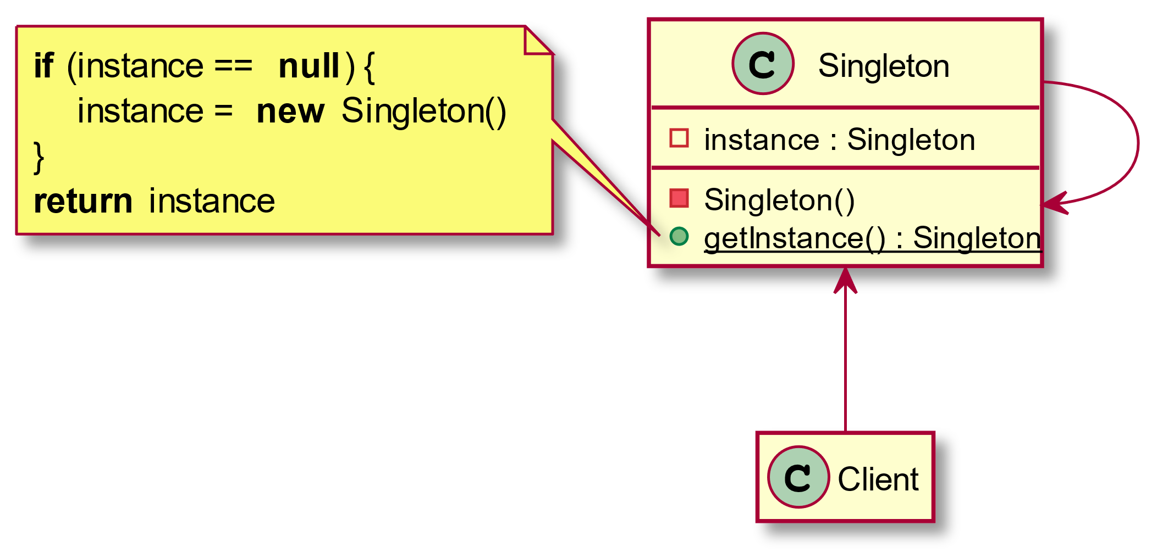

Slide 41
Singleton: Consequences
Reduces namespace pollution
Makes it easy to change your mind & allow more than one instance
Allow extension by subclassing
Same drawbacks of a global if misused
Implementation may be less efficient than a global
Concurrency/cache pitfalls & communication overhead

Slide 42
Singleton: Examples
Design Patterns: Singleton in Java (refactoring.guru)
Java Singleton Design Pattern Example Best Practices – JournalDev

Slide 43

Dependency Injection

Slide 44
Dependency Injection: Problem
How can a class be independent of how the objects on which it depends are created?
How can the way objects are created be specified in separate configuration files?
How can an application support different configurations?

Slide 45
Dependency Injection: Solution
Dependency injection separates the creation of a client's dependencies from the client's behavior, which promotes loosely coupled programs and the dependency inversion and single responsibility principles.
Fundamentally, dependency injection is based on passing parameters to a method.
Dependency injection is an example of the more general concept of inversion of control.
For details: Inversion of Control Containers and the Dependency Injection pattern (martinfowler.com)

Slide 46
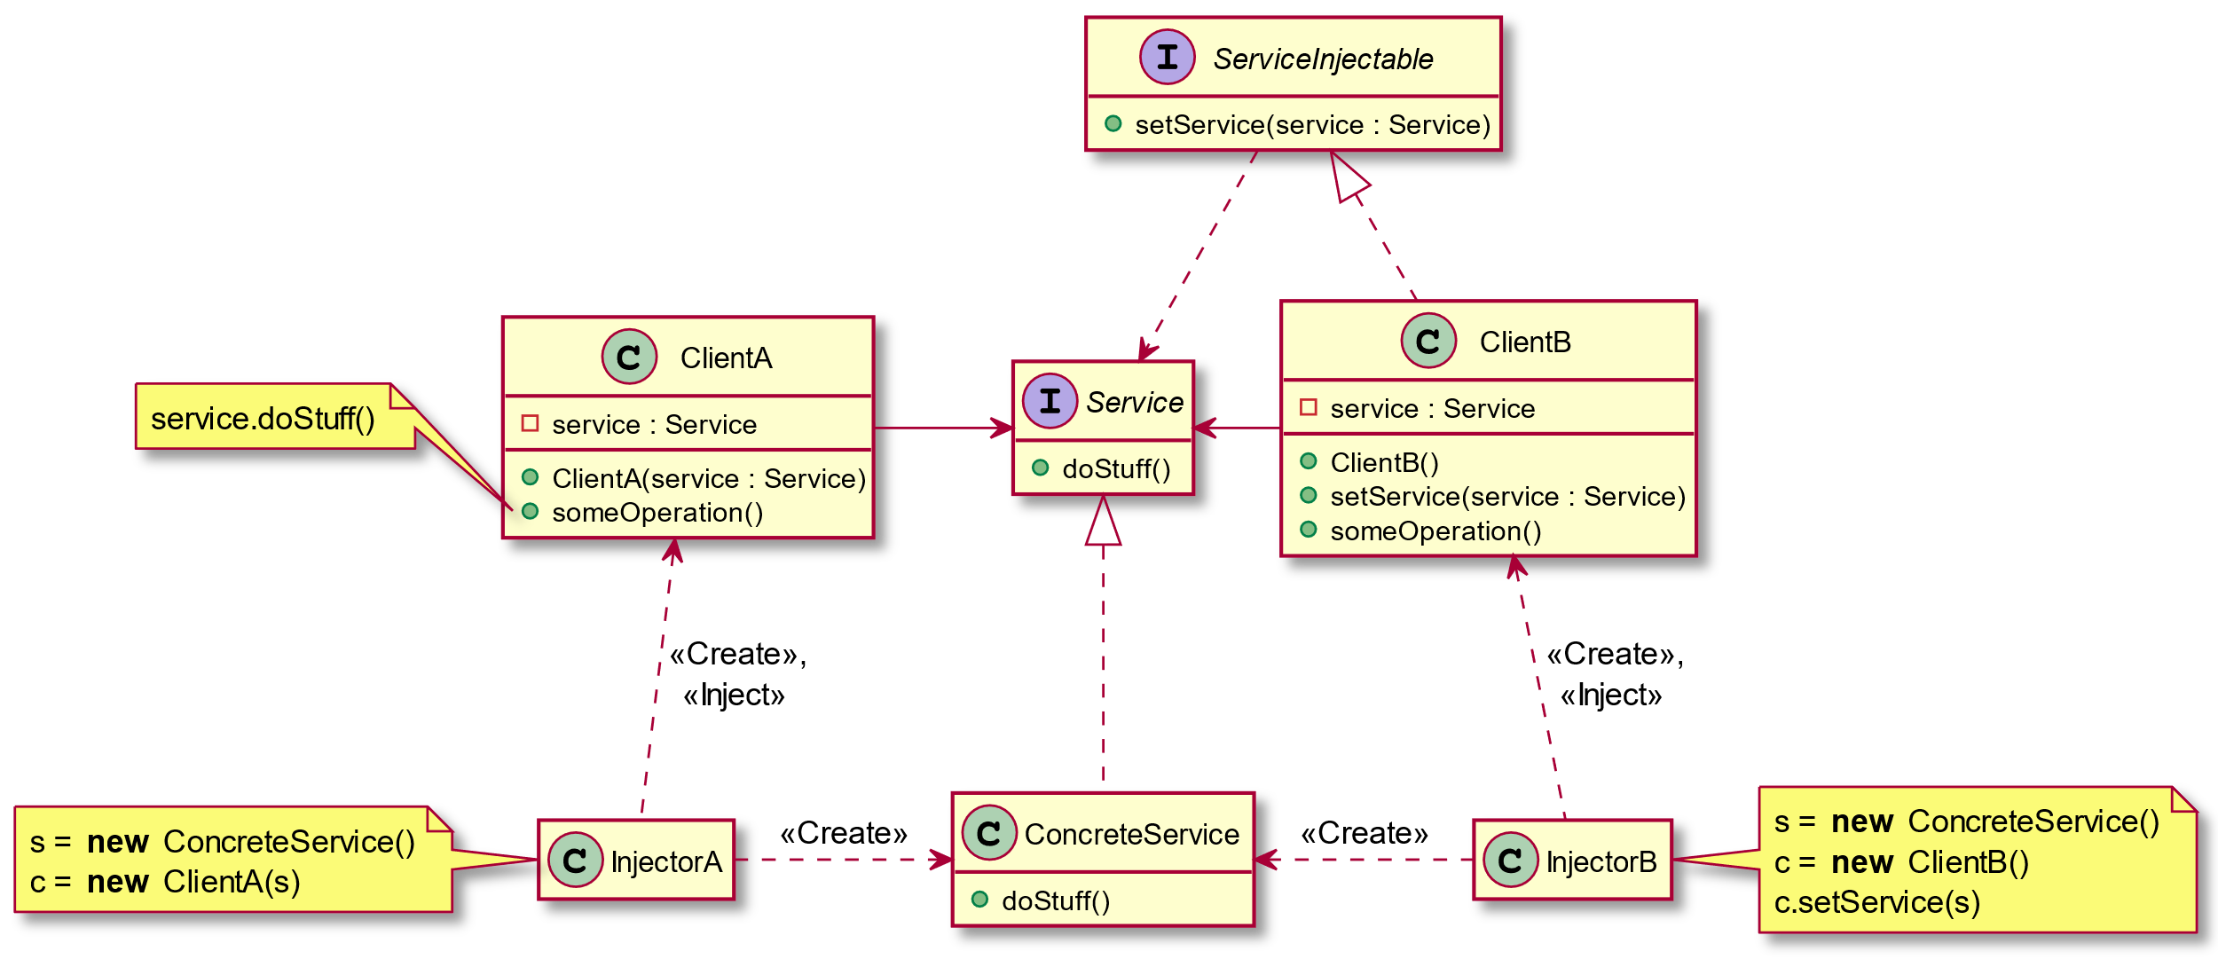

Slide 47
Dependency Injection: Consequences
Helps in Unit testing.
Boiler plate code is reduced, as initializing of dependencies is done by the injector component.
Helps to enable loose coupling, which is important in application programming.
It’s a bit complex to learn, and if overused can lead to management issues and other problems.
Many compile time errors are pushed to run-time.

Slide 48
Dependency Injection: Examples
Using dependency injection in Java - Introduction - Tutorial (vogella.com)
Java Dependency Injection - DI Design Pattern Example Tutorial – JournalDev
A quick intro to Dependency Injection: what it is, and when to use it (freecodecamp.org)

